Slide 1
The rise of emojis
温家伟
A22

Slide 2
the development of emojis
the smile emoticons made of characters
emoji emoticons built into various social software
self-created emoticons

Slide 3
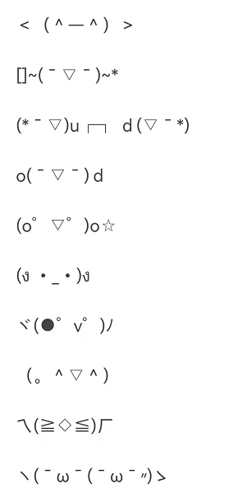
the smile emoticons made of characters

Slide 4
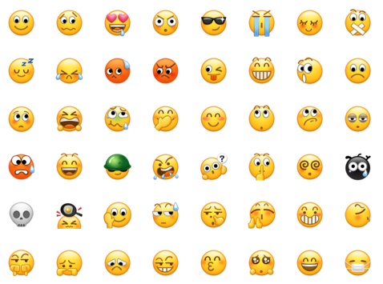
emoji emoticons built into various social software

Slide 5
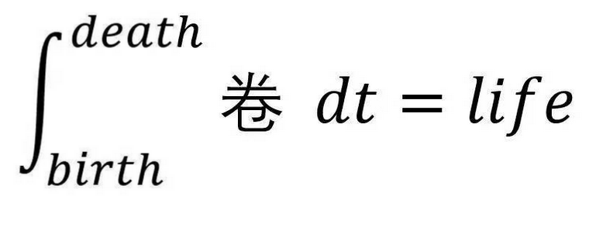
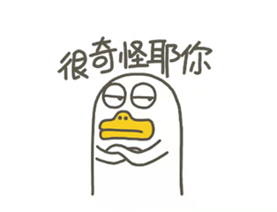
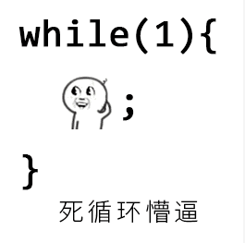
self-created emoticons

Slide 6
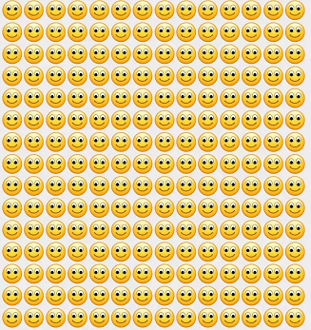
干啥啥不行，微笑第一名

Slide 7
Thanks for your listening.

